Slide 1
California Community College
Apportionment Process
Exhibit C

Slide 2
California Community College
Legislative Senate Bill 361
BOG Code: Title 5 Education
Division 6. California Community Colleges Chapter 9. Fiscal Support
Sub-chapter 8, Community College General Apportionment Process
https://govt.westlaw.com/calregs/Browse/Home/California/CaliforniaCodeofRegulations?guid=I013D6300D48611DEBC02831C6D6C108E&originationContext=documenttoc&transitionType=Default&contextData=%28sc.Default%29

Slide 5
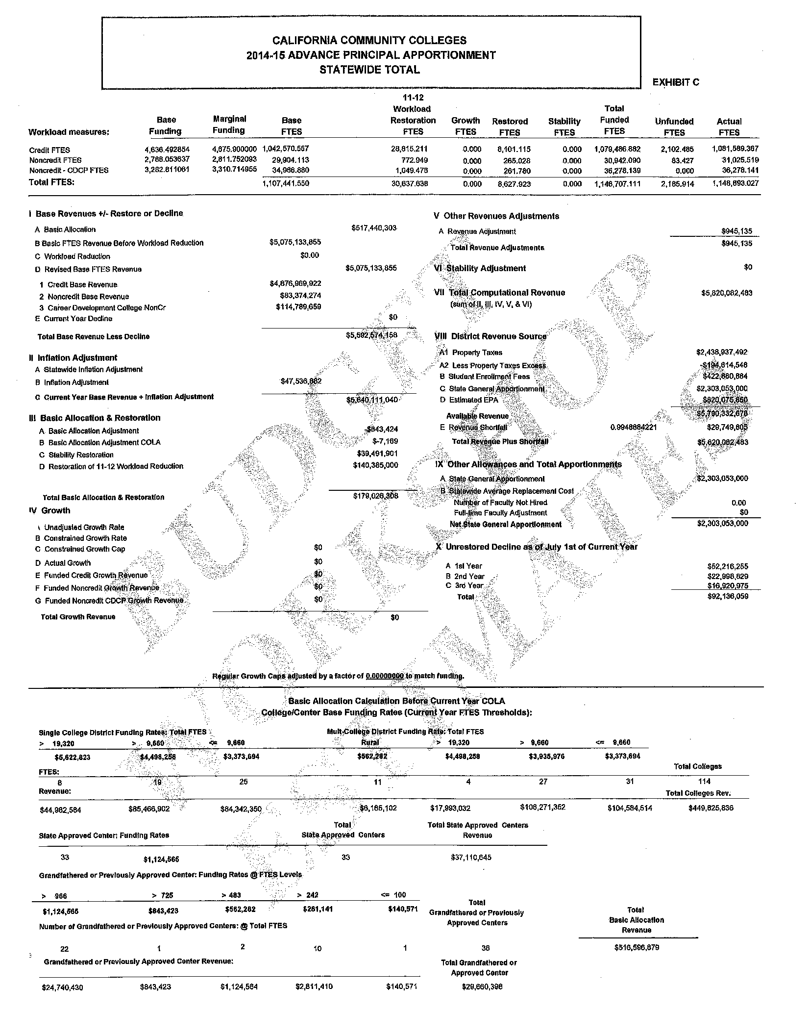

Slide 6
HYPERLINKS
2014-15 Advance Principle Apportionment
http://extranet.cccco.edu/Portals/1/CFFP/Fiscal_Services/Apport/2014-15/AD/ex_c_1415ad_072114_4_watermark.pdf

Slide 7
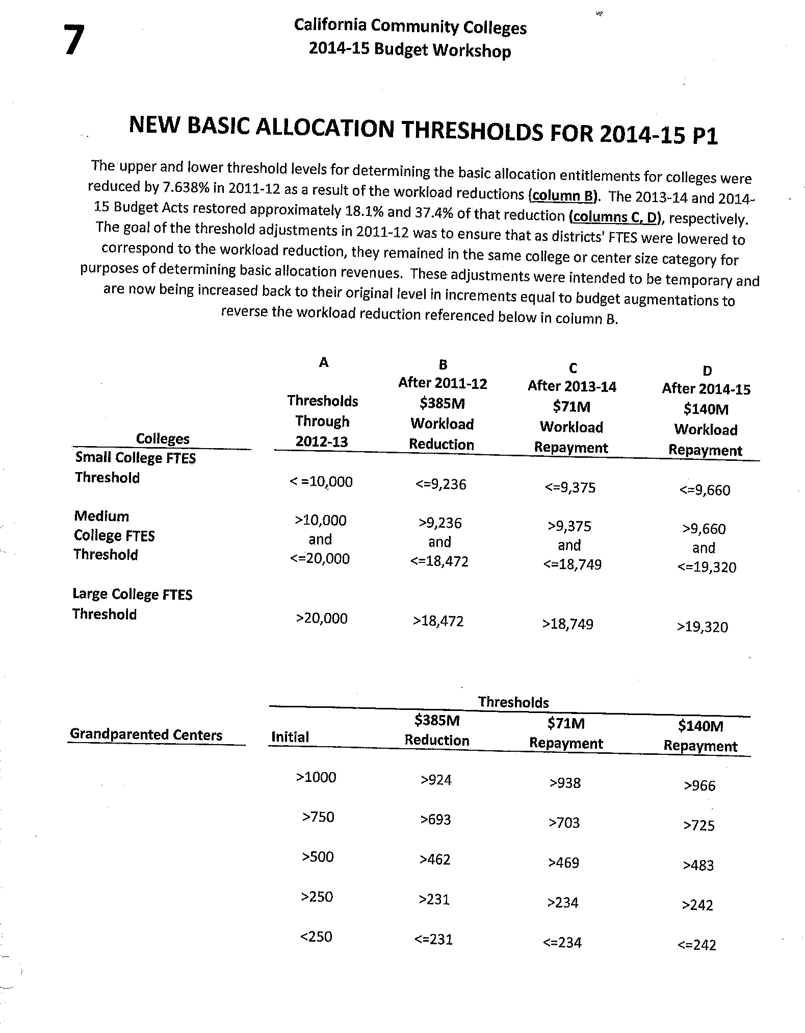

Slide 8
CALIFORNIA COMMUNITY COLLEGES 2014-15 ADVANCE PRINCIPAL APPRORTIONMENT STATEWIDE TOTAL
Base Revenues +/- Restore or Decline
A. Basic Allocation
B. Basic FTES Revenue Before Workload Reduction
C. Workload Reduction
D. Revised Base FTES Revenue
1. Credit Base Revenue
2. Noncredit Base Revenue
3. Career Development College NonCr
E. Current Year Decline
TOTAL BASE REVENUE LESS DECLINE

Slide 9
CALIFORNIA COMMUNITY COLLEGES 2014-15 ADVANCE PRINCIPAL APPRORTIONMENT STATEWIDE TOTAL
II. Inflation Adjustment
A. Statewide Inflation Adjustment
B. Inflation Adjustment
C. Current Year Base Revenue + Inflation Adjustment

Slide 10
CALIFORNIA COMMUNITY COLLEGES 2014-15 ADVANCE PRINCIPAL APPRORTIONMENT STATEWIDE TOTAL
III. Basic Allocation & Restoration
A. Basic Allocation Adjustment
B. Basic Allocation Adjustment COLA
C. Stability Restoration
D. Restoration of 11-12 Workload Reduction

Slide 11
CALIFORNIA COMMUNITY COLLEGES 2014-15 ADVANCE PRINCIPAL APPRORTIONMENT STATEWIDE TOTAL
IV. Growth
A. Unadjusted Growth Rate
B. Constrained Growth Rate
C. Constrained Growth Cap
D. Actual Growth
E. Funded Credit Growth Revenue
F. Funded Noncredit Growth Revenue
G. Funded Noncredit CDCP Growth Revenue
TOTAL Growth Revenue

Slide 12
CALIFORNIA COMMUNITY COLLEGES 2014-15 ADVANCE PRINCIPAL APPRORTIONMENT STATEWIDE TOTAL
V. Other Revenues Adjustments
A. Revenue Adjustment
TOTAL Revenue Adjustments

Slide 13
CALIFORNIA COMMUNITY COLLEGES 2014-15 ADVANCE PRINCIPAL APPRORTIONMENT STATEWIDE TOTAL
VI. Stability Adjustments

Slide 14
CALIFORNIA COMMUNITY COLLEGES 2014-15 ADVANCE PRINCIPAL APPRORTIONMENT STATEWIDE TOTAL
Total Computational Revenue
(Sum of II, III, IV, V, & VI)

Slide 15
CALIFORNIA COMMUNITY COLLEGES 2014-15 ADVANCE PRINCIPAL APPRORTIONMENT STATEWIDE TOTAL
District Revenue Source
A1. Property Taxes
A2. Less Property Taxes Excess
B. Student Enrollment Fees
C. State General Apportionment
D. Estimated EPA
Available Revenue
E. Revenue Shortfall
Total Revenue Plus Shortfall

Slide 16
CALIFORNIA COMMUNITY COLLEGES 2014-15 ADVANCE PRINCIPAL APPRORTIONMENT STATEWIDE TOTAL
IX Other Allowances and Total Apportionments
A. State General Apportionment
B. Statewide Average Replacement Cost
Number of Faculty Not Hired
Full-time Faculty Adjustment
Net State General Apportionment

Slide 17
CALIFORNIA COMMUNITY COLLEGES 2014-15 ADVANCE PRINCIPAL APPRORTIONMENT STATEWIDE TOTAL
X Unrestored Decline as of July 1st of Current Year
A. 1st Year
B. 2nd Year
C. 3rd Year
TOTAL

Slide 18
CATEGORICALS

Slide 19
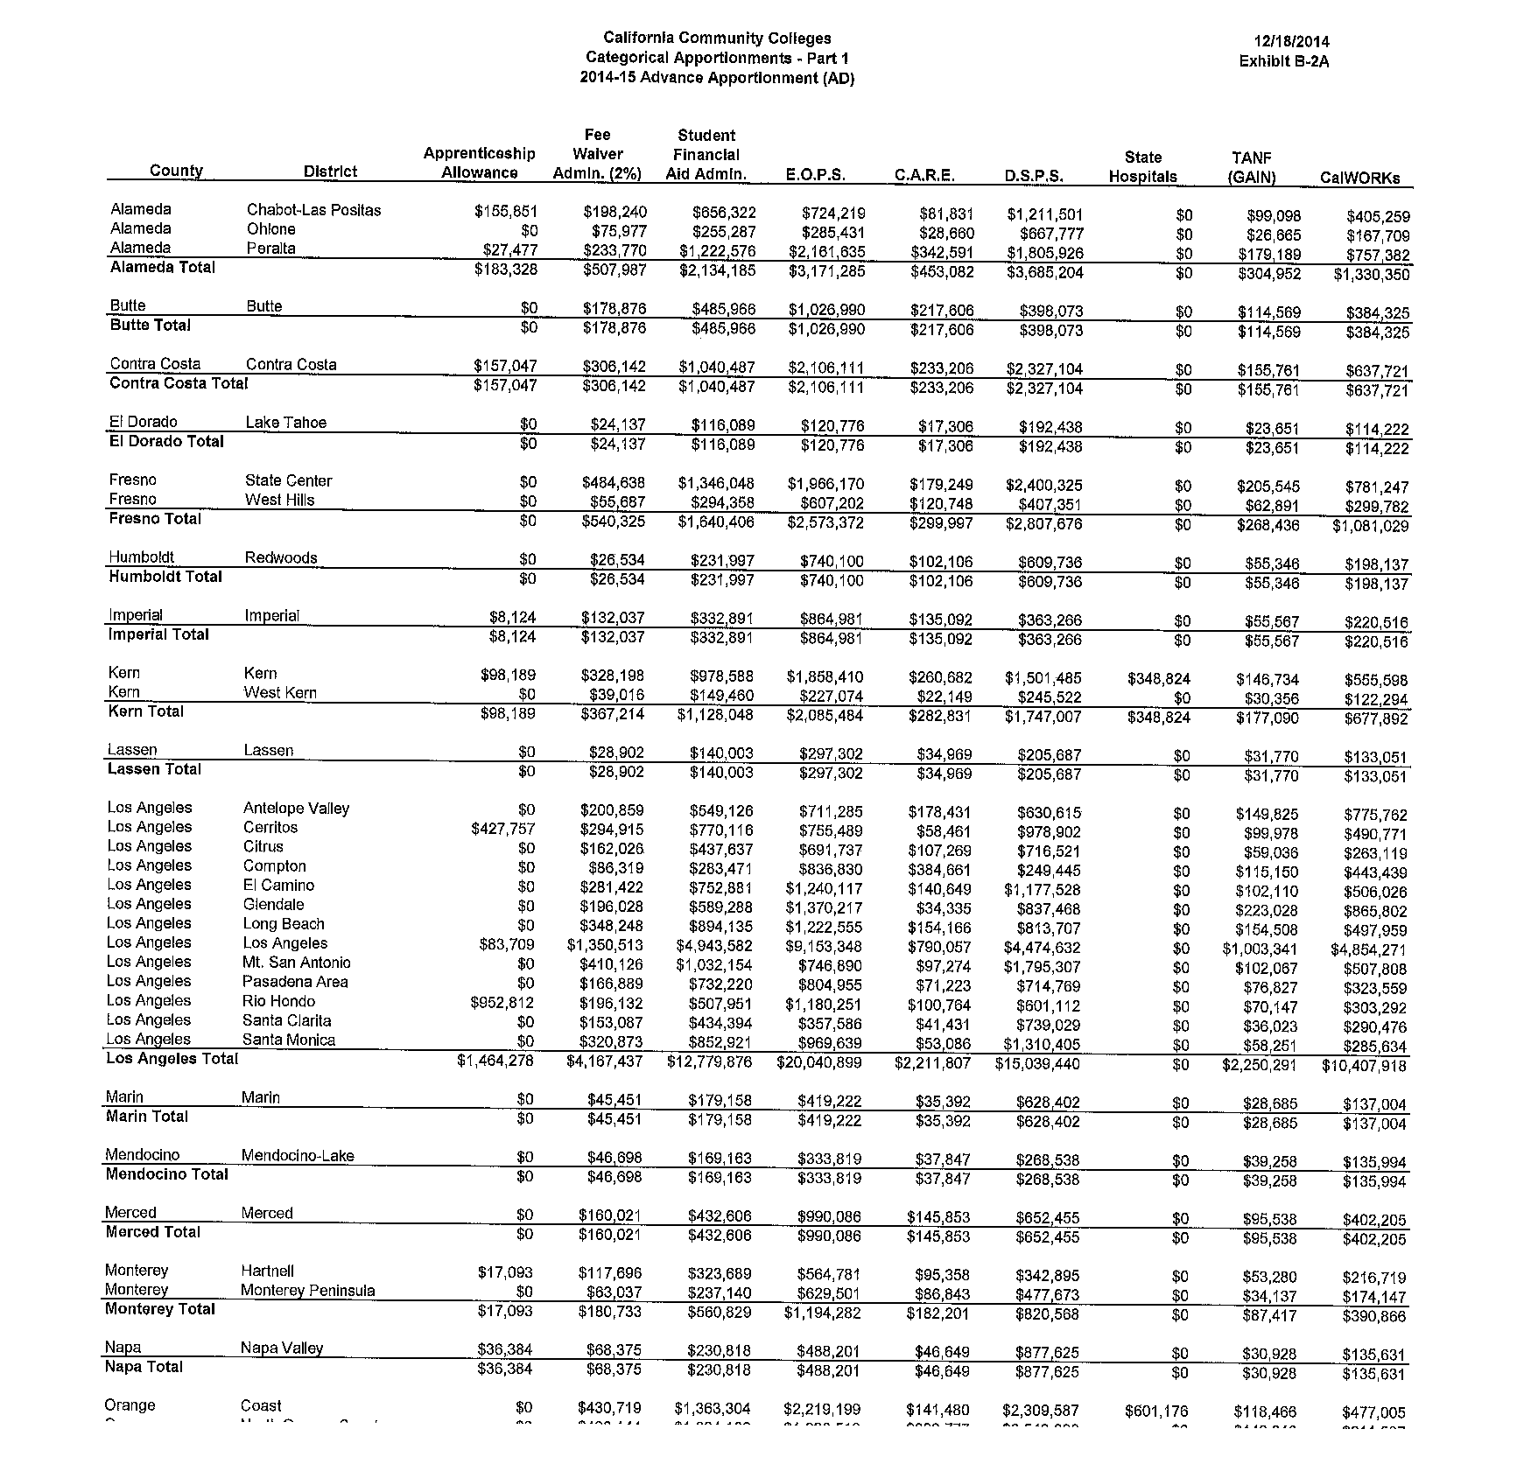

Slide 20
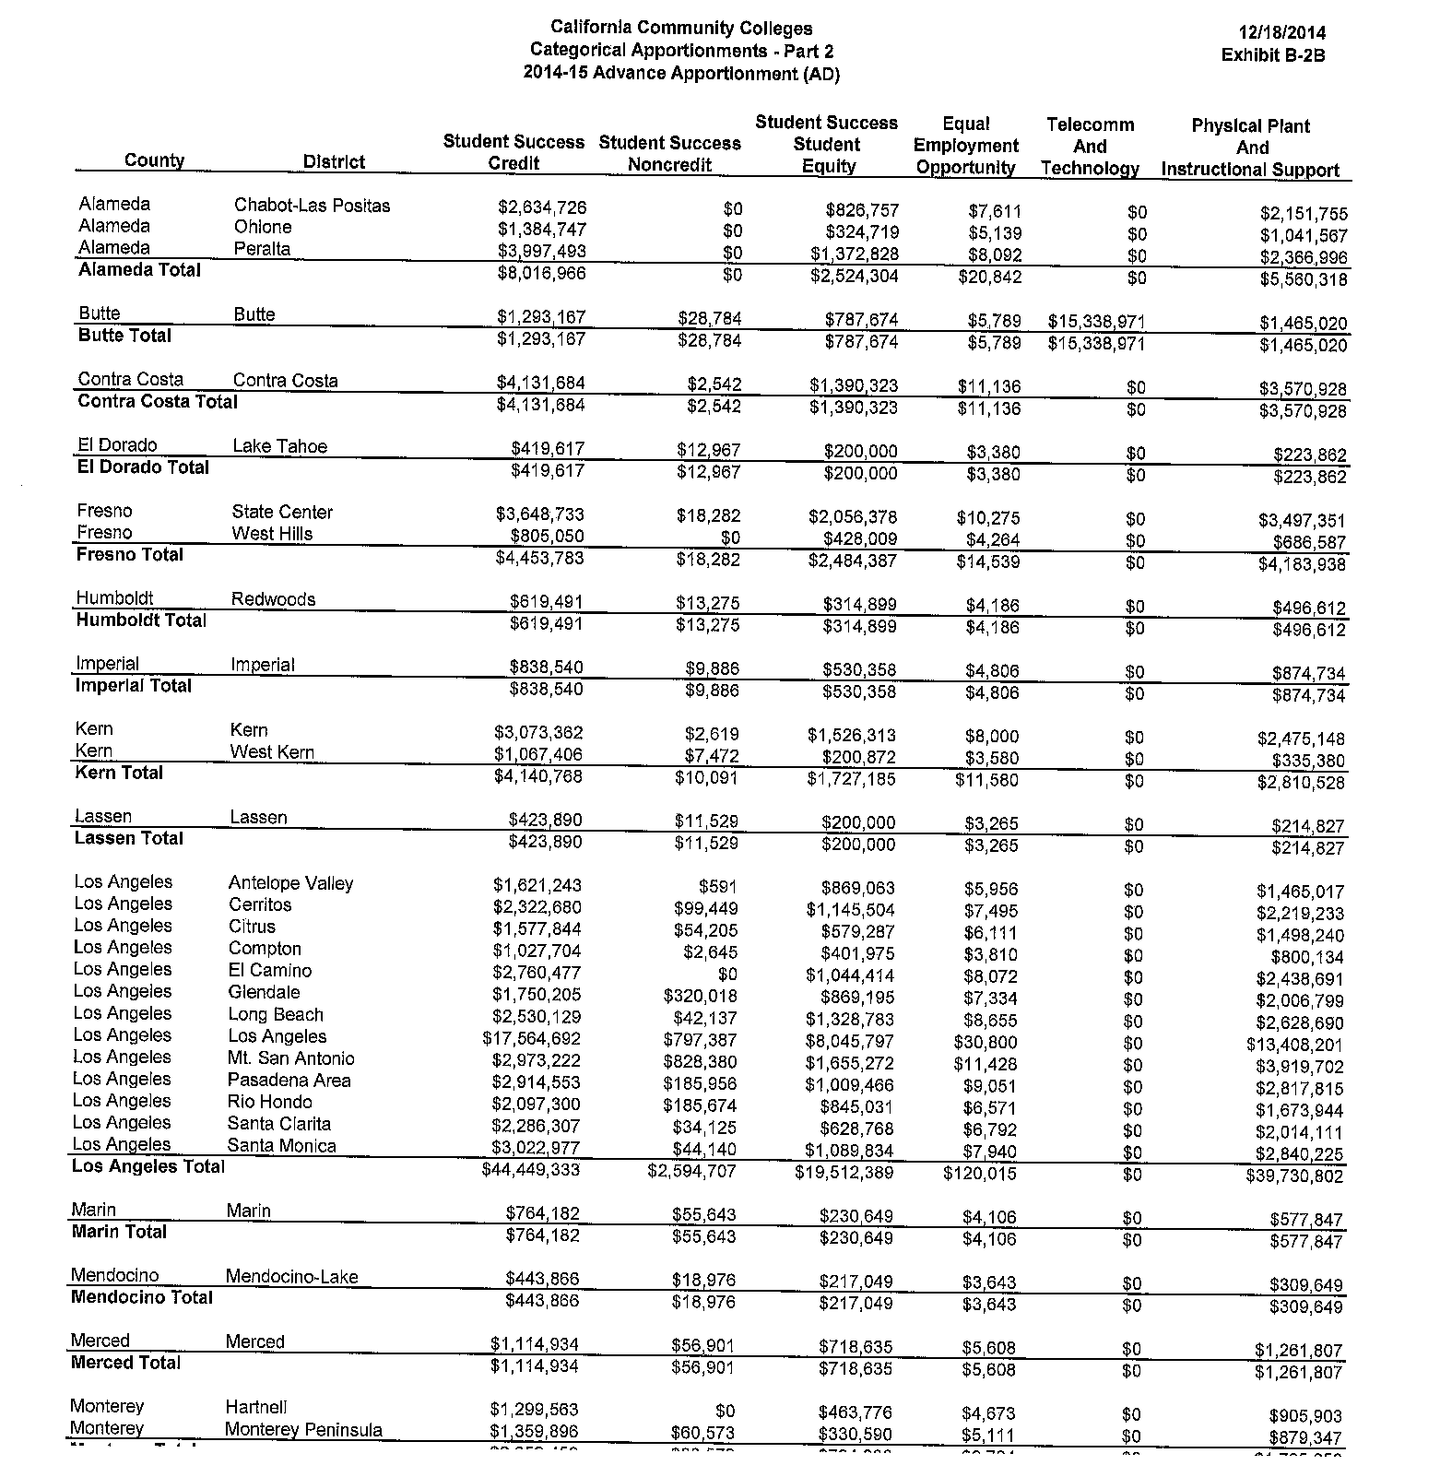

Slide 21
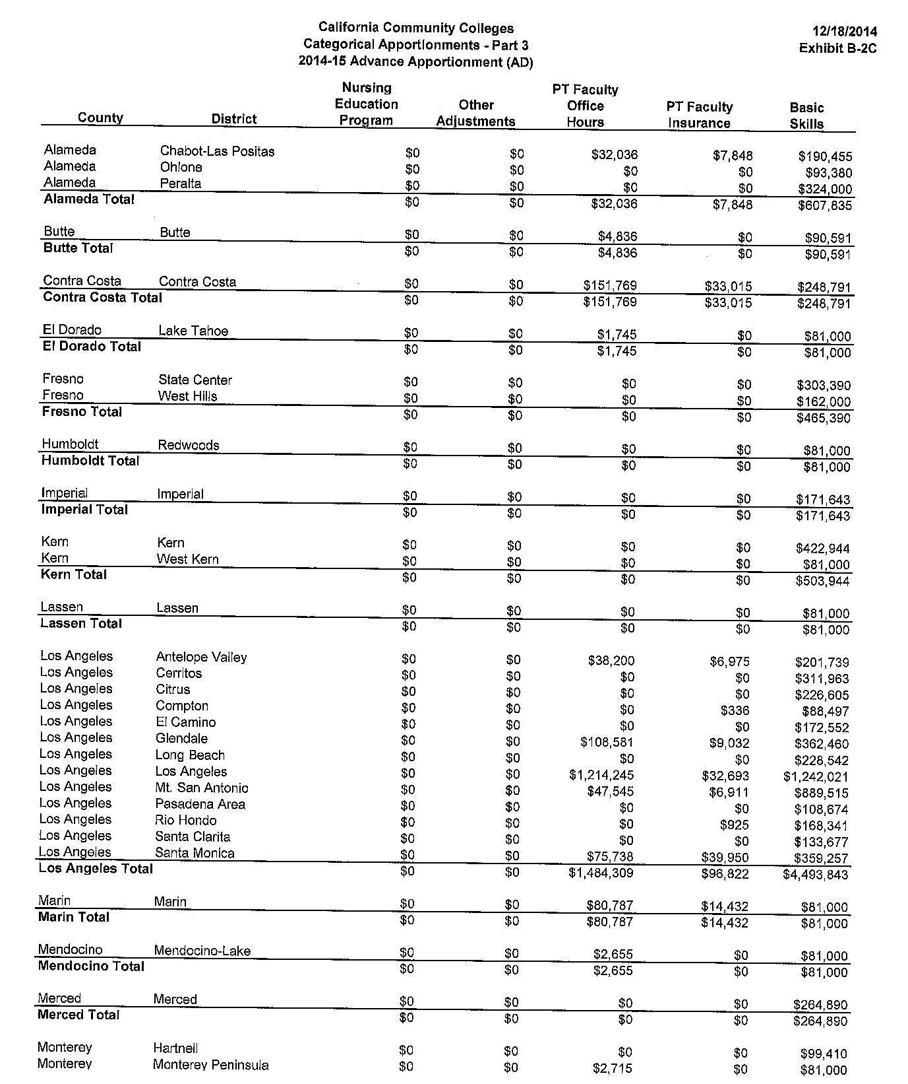

Slide 22
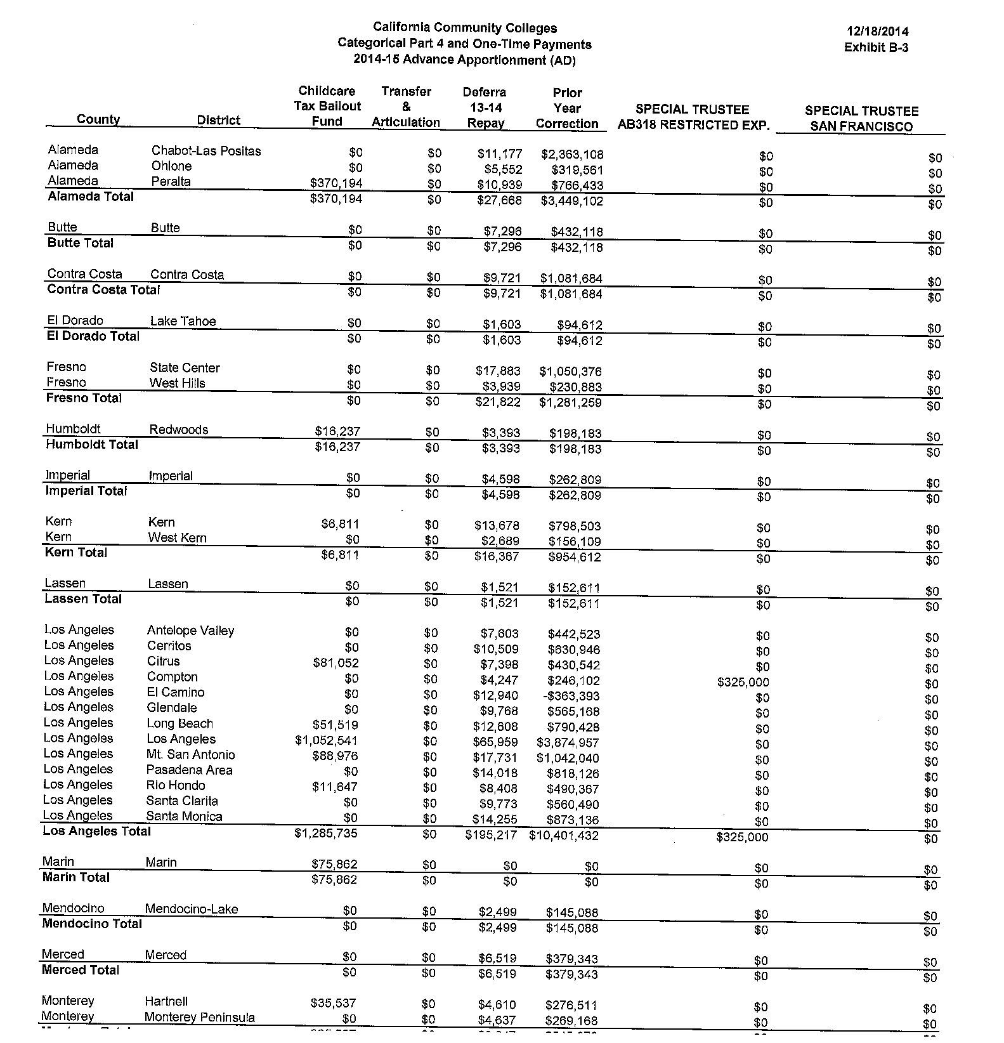

Slide 23
HYPERLINKS
Categoricals
http://extranet.cccco.edu/Portals/1/CFFP/Fiscal_Services/Apport/2014-15/AD/AD%203%20December%20Update/Exhibit_B-2A_14-15_AD_3_Dec_Categorical_Apportionments-Part_1.pdf
http://extranet.cccco.edu/Portals/1/CFFP/Fiscal_Services/Apport/2014-15/AD/AD%203%20December%20Update/Exhibit_B-2B_14-15_AD_3_Dec_Categorical_Apportionments-Part_2.pdf
http://extranet.cccco.edu/Portals/1/CFFP/Fiscal_Services/Apport/2014-15/AD/AD%203%20December%20Update/Exhibit_B-2C_14-15_AD_3_Dec_Categorical_Apportionments-Part_3.pdf
http://extranet.cccco.edu/Portals/1/CFFP/Fiscal_Services/Apport/2014-15/AD/AD%203%20December%20Update/Exhibit_B-3_14-15_AD_3_Dec_Categorical_Apportionments-Part_4_and_One-Time_Funds_%28no_EPA%29.pdf

Slide 24
CASH FLOW

Slide 25
State General Apportionments (Monthly Payments)
July 8%
August 8%
September 12%
October 10%
November 9%
December 5%
January 8%
February 8%
March 8%
April 8%
May 8%
June 8%

Slide 26
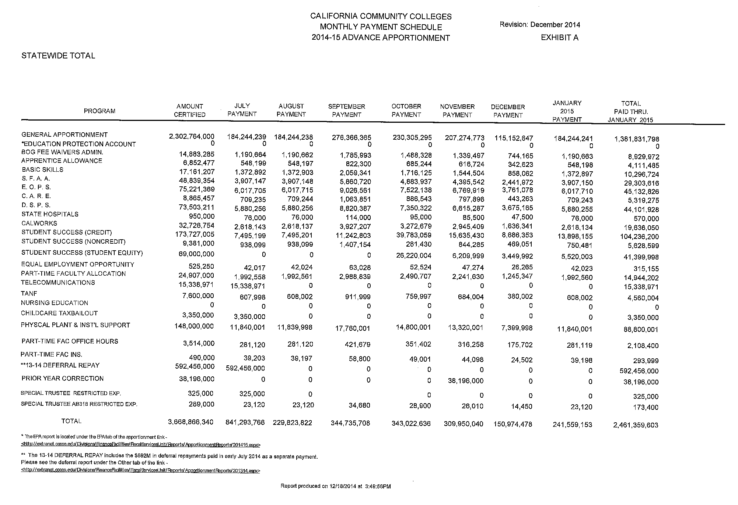

Slide 27
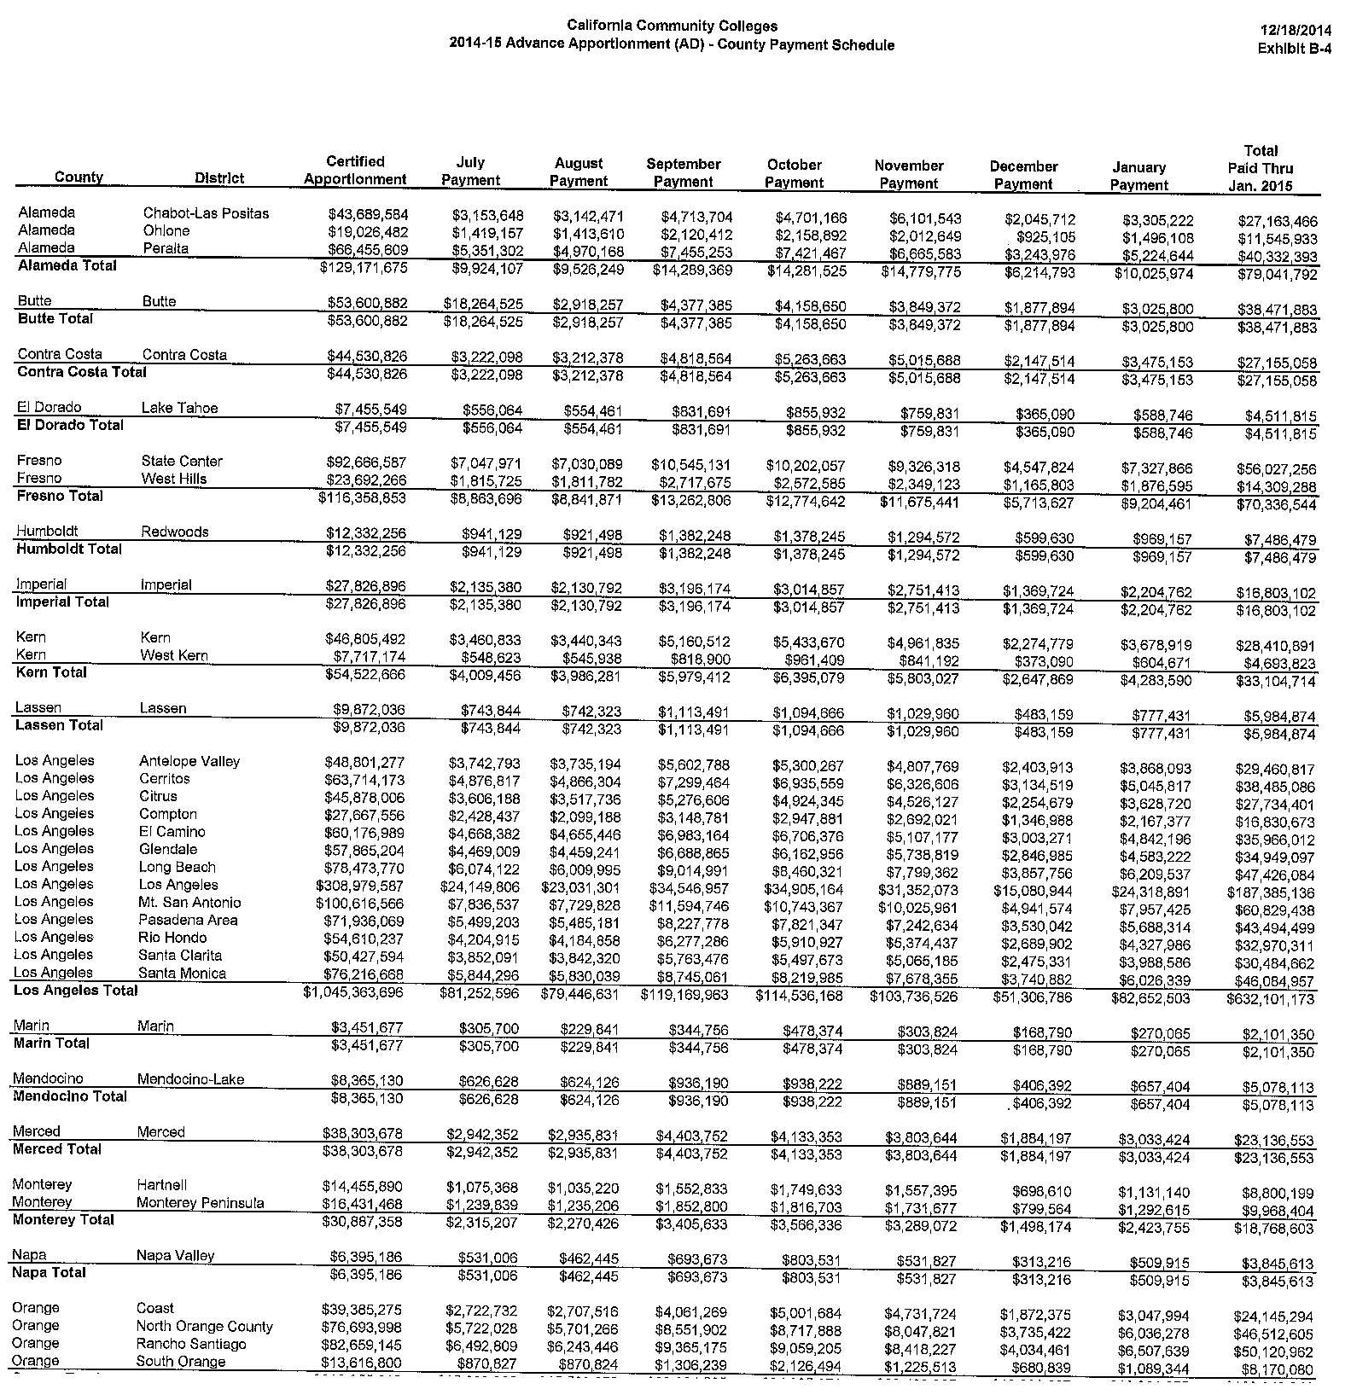

Slide 28
HYPERLINKS
Cashflow
http://extranet.cccco.edu/Portals/1/CFFP/Fiscal_Services/Apport/2014-15/AD/AD%203%20December%20Update/ex_a_1415ad_footnote_121814_3.pdf
http://extranet.cccco.edu/Portals/1/CFFP/Fiscal_Services/Apport/2014-15/AD/AD%203%20December%20Update/Exhibit_B-4_14-15_AD_3_Dec_County_Payment_Schedule_%28no_EPA%29.pdf

Slide 29
